Slide 1
Define and describe operating systems which contain a Command Line Interface (CLI)
Define and describe operating systems which contain a Graphical User Interface (GUI)
Describe the differences, including the benefits and drawbacks, between operating systems which contain a CLI and those which contain a GUI

Slide 2
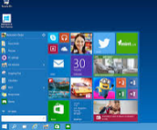


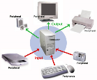

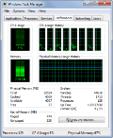
Fill in the blanks
An operating system is a _________ software that _________ the general operation of a ___________ system:
Helps the user _________ with the computer through a graphical user interface.
Provides _________ and prevents unauthorised ________ to a system.
Helping _______, organise, find and delete _________.
Manages ________, output and backing _________.
Allows users to load, run and store ______________. Also resolve errors occurring applications
Decided what should be __________ and deleted from __________.
loaded
security
graphical
System
applications
save
Computer
Manages
Interact
memory
Access
file
devices

Slide 3
 | 1
 |  |  | 2 |  |  |  |  |  | 3
1
 |  |  |  |  |  |  | 2
 |  |  |  |  |  |  |  |  |  |  |  | 4
 |  |  |  |  |  |  | 3
4
 |  |  |  |  |  |  |  |  |  |  |  |  |  | 5
5
Down
Small images used to represent folders/applications/files
List of options
Used to select options
CLI command to check a disk and display status
Four main features for a GUI
Across
Used in CLI
Areas for displaying information
GUIs are built around this.
GUI
CLI

Slide 4

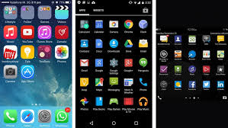
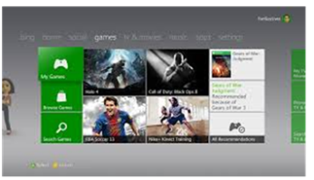
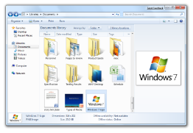


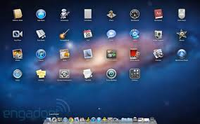
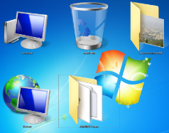

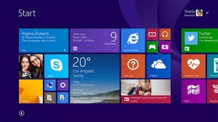
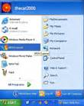
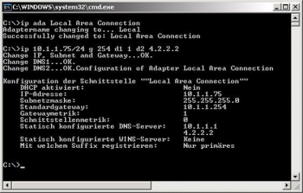
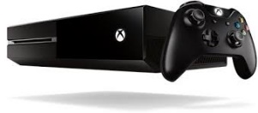

Match up the user interfaces.
WIMP (Windows, Icons, Menus and Pointers)
 | Explain the benefit:
W |  | Windows:
I |  | Icons:
M |  | Menus:
P |  | Pointers:

Slide 5
GUI Vs CLI
1) Why is it easier to learn to use a GUI interface?
2) Give one example of a GUI interface and one feature that you like?
3) Why would you not recommend a user to use a CLI interface?
4) Who do you think would use a CLI interface and give one reason?

